Slide 1
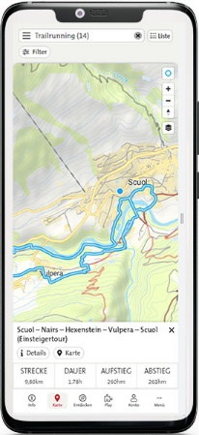
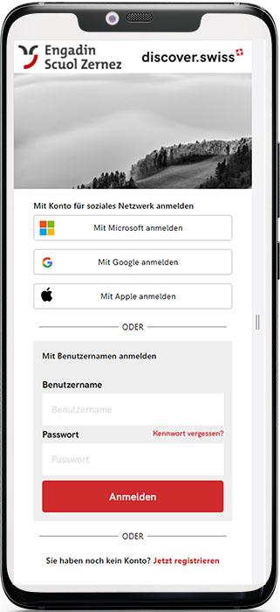
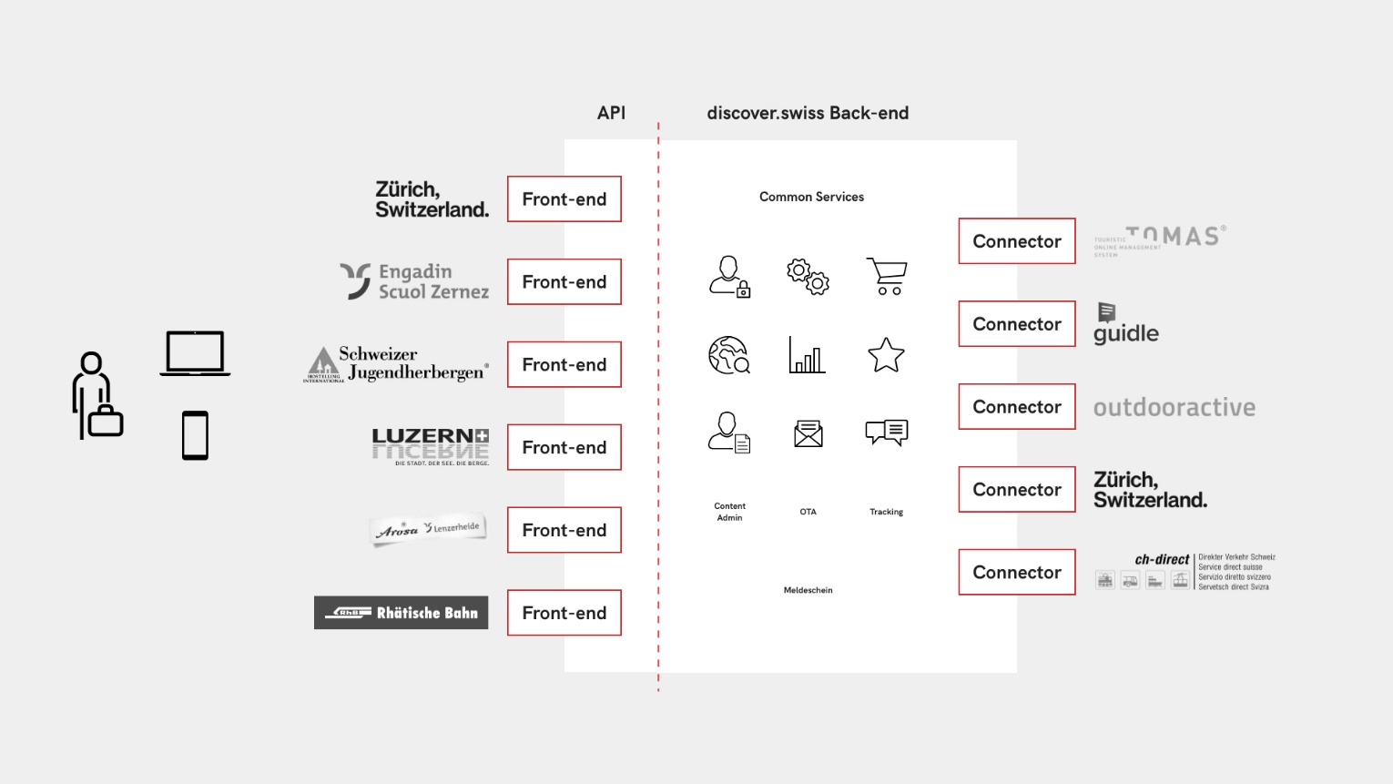
discover.swiss – benefits for our tourism organisatzion
Dominik Täuber, Head of Web & Social Media

Slide 2
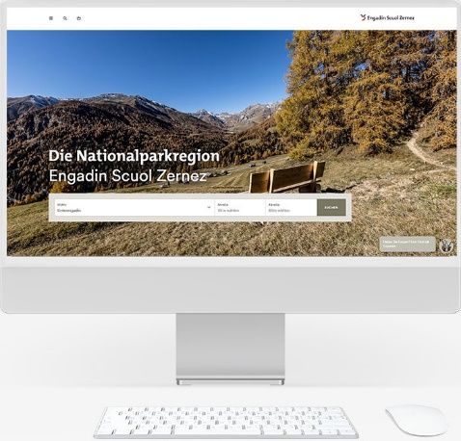
discover.swiss - Usage
discover.swiss
Guidle
Events
Webcams
Common services
Info-Center
Marketplace
User profile
Services
Tomas
Accomodations
Offers
Outdooractive
Tours
POIs

Slide 3
Advantages
Data protection
Professional
Benefits
Only one data interface with high quality
Use of services that would otherwise be impossible to finance
Further developments
myData-approach
Quality
Transparency
Cost
efficiency
Swiss made

Slide 4
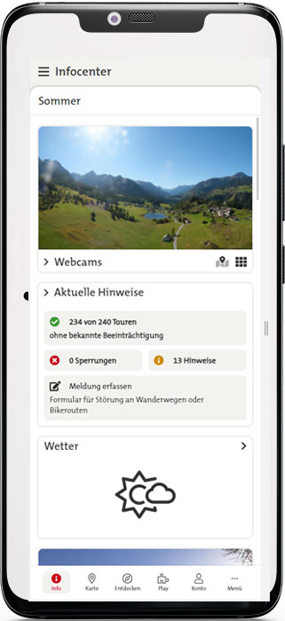
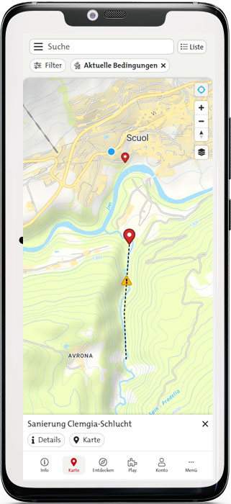
engadin.app – projects: Status information
Daily updated information about the state of the infrastructure
Cooperation with the municipality
Guests can report damage and influences
Forwarding of the status to as many platforms as possible via discover.swiss

Slide 5
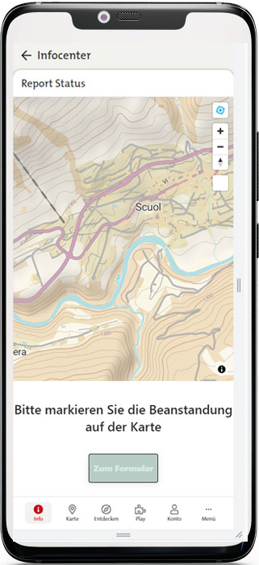
engadin.app – projects: Status information
Outdooractive
Distribution of information to as many, relevant channels as possible, where guests can get information.
discover.swiss
Schweiz Mobil
engadin.app

Slide 6
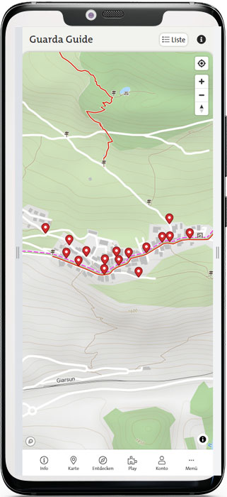
engadin.app – projects: Further developments
Marketplace with a mixed shopping cart
Expansion of the user profile
Expansion of Gamification & Guides
Integration of the guest card with ÖV-Inclusive

Slide 7
Discussion

